Slide 1
InPostor
Piotr Czapla 116634 Juliusz Szymajda 116726 Malwina Schonhofer 116718 Maciej Adamczewski 116748

Slide 2


Product concept
InPostOr offers the possibility to order a parcel to an InPostOr Locker or collection point. This eliminates the need to wait for a courier. The customer can collect the parcel during the opening hours of the ACP or at any time from the Locker.
InPostor Locker
Online Store
Client
ACP

Slide 3



Target group(s)
Online shop owners wishing to expand delivery options for their goods.
Customers of online shops needing flexible pick-up times for their packages.

Slide 4

Benefits
Until now, online shopping involved waiting for a courier, often without knowing at what times or on what day the package would be delivered. Through the use of InPostOr Lockers, online shopping is more accessible to people who, for various reasons, do not want or cannot use a traditional courier service by being available 24/7. This increases the pool of potential customers for our target users.

Slide 5
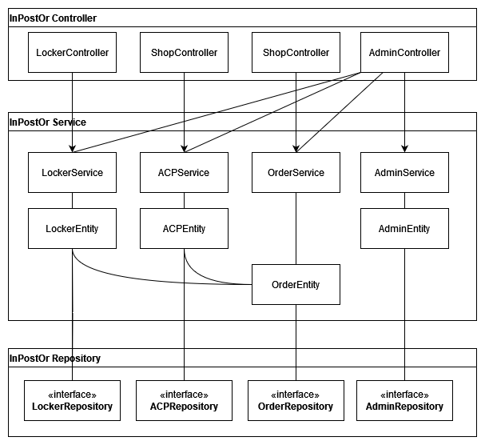
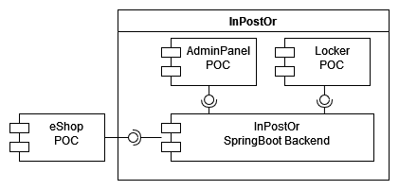
System architecture

Slide 6
Implemented technologies
SpringBoot
H2 Database
Log4j
Jacoco
JUnit Jupiter 5
SonarCloud

Slide 7

Demonstration of implemented work

Slide 8
How did we work?
Agile project management and assignment of work. Story-driven development with 7 sprints managed in Jira.
Cooperative development and integration of new increments. Branches for each main feature/component. Pull requests reviewed by teammembers. Pull requests trigger automated tests and static code analysis with use of SonarCloud.
Notes and less formal tasks managed in Notion. Subpages for each role and team member.
Standardisation of test naming. Easier understanding and reuse of implemented tests.

Slide 9
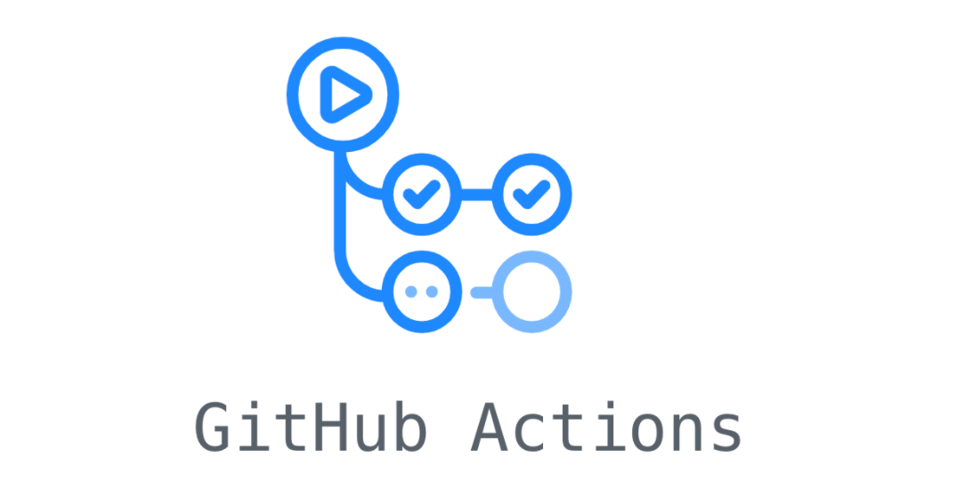

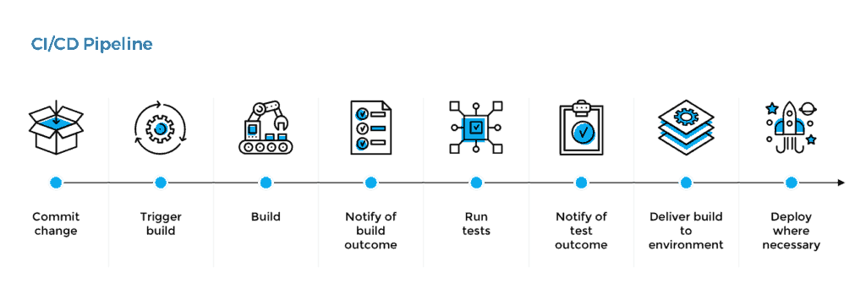
CI Pipeline

Slide 10
Practices and check of quality
Story-driven development using Jira and Notion
Peer reviewing pull-requests which trigger automated tests and static code analysis which determines whether or not changes can be merged.
We also used SonarLint plug-in which would warn us in case there is a lethal error during it's analysis.
The metric which showed us if we can move on or not were criteria from SonarCloud such as Quality Gate, code smells, vulnerabilities and security hotspots.

Slide 11

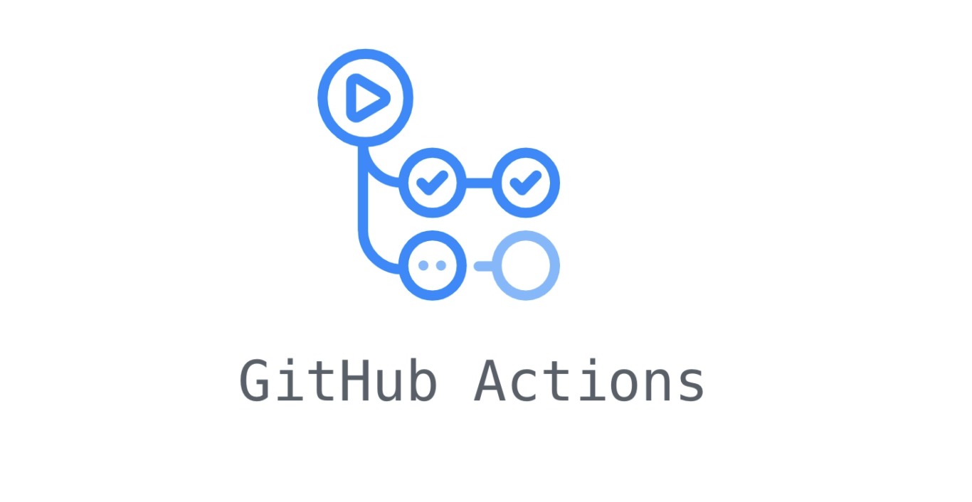


CD Pipeline

Slide 12
Noted strengths and weaknesses
Everyone knows what they need to work on.
Fair tasks division.
Increased code consistency and understanding.
Easier to maintain a coherent project structure.
Difficulty in maintaining a consistent work pace.
Obstructed progress when other people's tasks are delayed.
Unfamiliarity with new technologies hinders rather than aids.

Slide 13

Lessons learned Key Takeaways for Future Success
Maintain a Balance
Effective Communication
Collaborative Dependencies
Embrace Learning

Slide 14
THANK YOU FOR YOUR ATTENTION

